Slide 1
Leave No Question Behind! Broadening the Scope of Machine Comprehension
Daniel Khashabi Allen Institute for AI Joint w/ Tushar Khot, Ashish Sabharwal, Hanna Hajishirzi, Oyvind Tafjord, Peter Clark
Notes:
Glad to be here. If you have any clarification questions, please interrupt me; otherwise, let’s delay all the open-ended questions till after the talk.
- before I start, let me mention that these are joint work with a bunch of folks that you probably know.

Slide 2
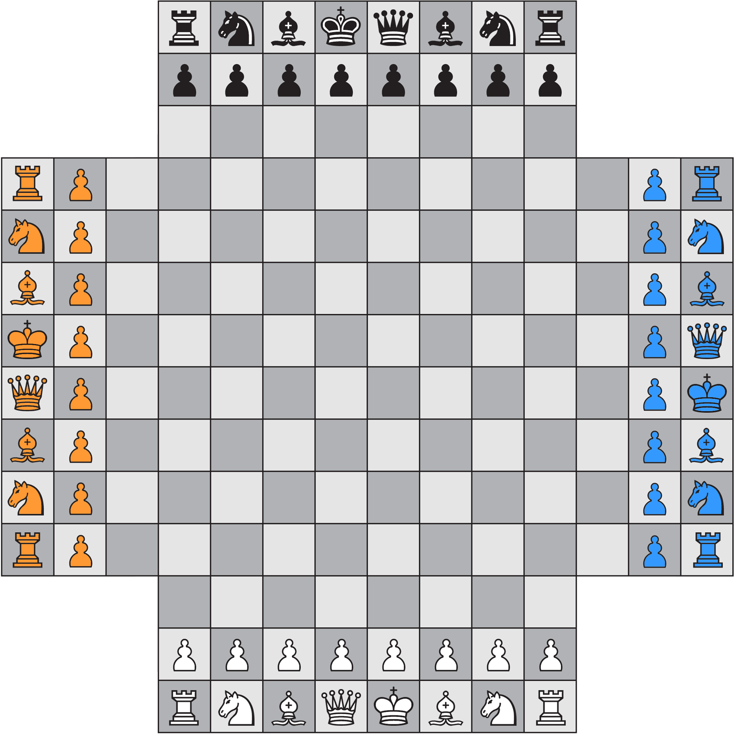
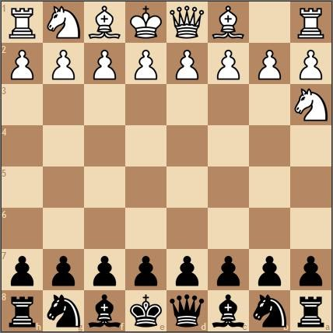
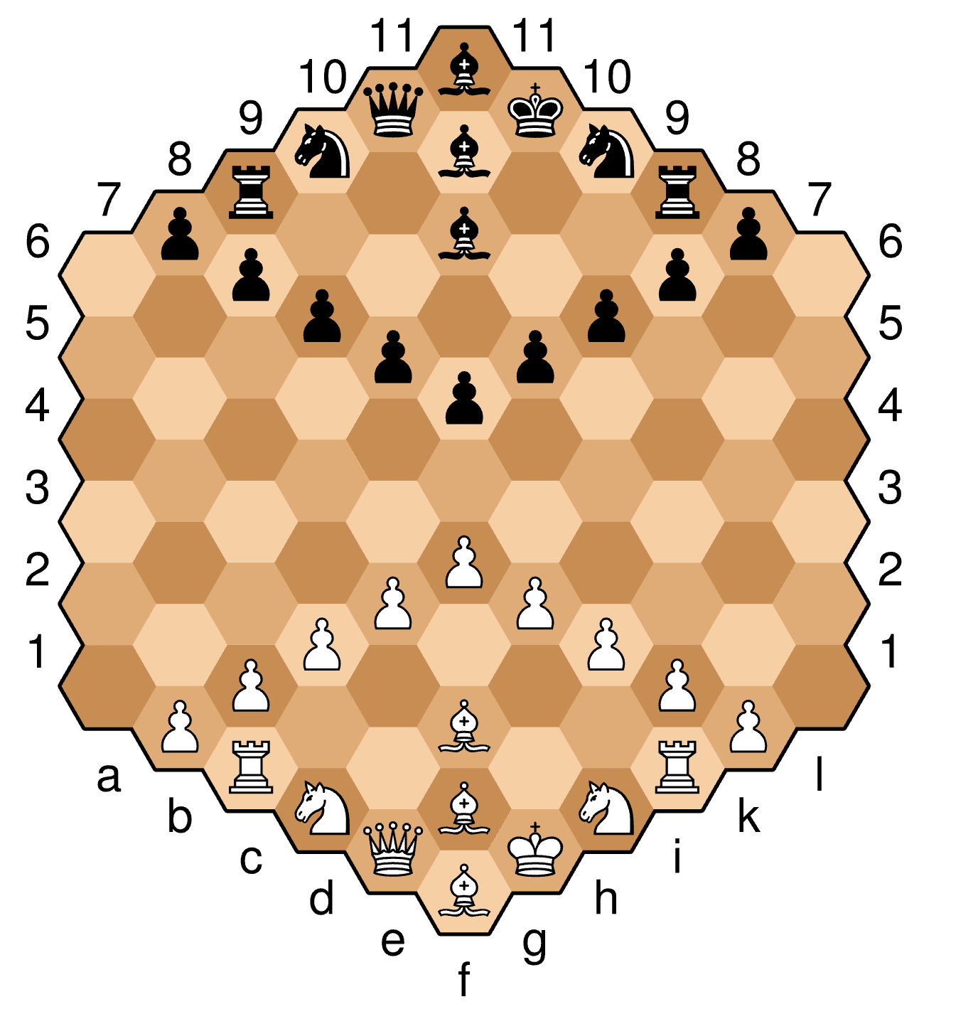
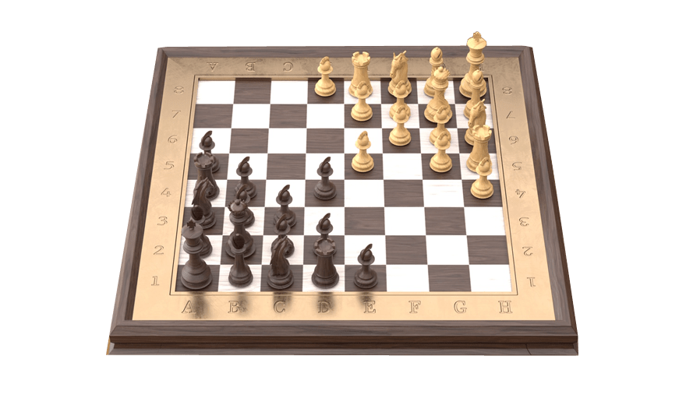
Pandemic Anecdote: Chess
Humans generalize to “unseen” variants of chess.
The standard chess is considered a “solved” problem for AI.
Yet, no system can generalize across chess variants.
Notes:
Let me start with a little bit of anecdote here:
During this pandemic, I got the habit of playing online chess;
And not just the standard chess, but different variants that I was not aware of; various boards; Various number of players, etc.
Interestingly, all these variants, have the same basic principles. So, if you know the standard chess, it is relatively easy to switch between various variants.
Now if you think about state of AI in chess:
Chess is usually considered a ”solved” problem for AI.
Yet, there is no system that can learn about basic principles of chess and seamlessly generalize to an unseen chess variant.
Which goes to show how “narrow” our tasks definitions in AI are.

Slide 3
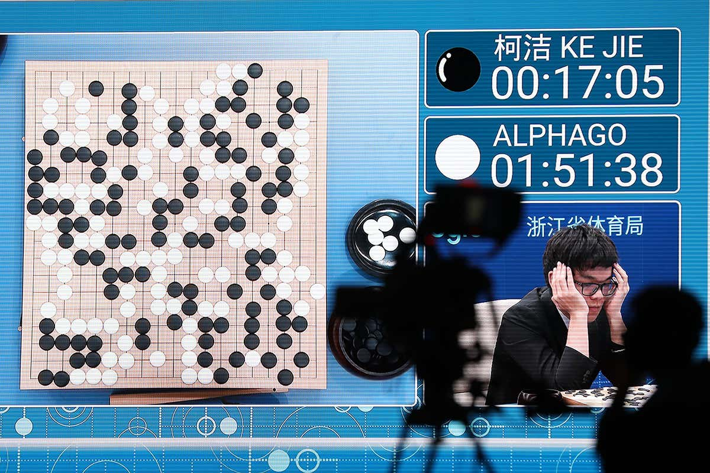
AlphaGo: The Success
Notes:
Let me start by remembering one of the widely-known successes of AI.
Just a few years ago, AlphaGO defeated the human world champion, in the ancient game of Go, followed by lots of excitement about the new heights that AI has achieved.

Slide 4
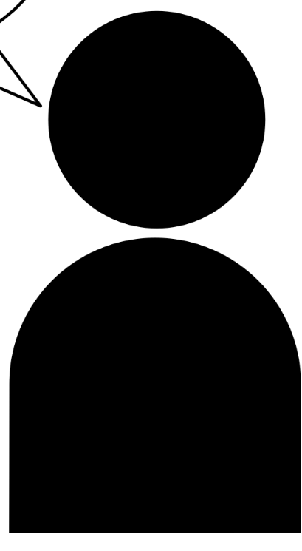

AlphaGo: The Not-So-Successful Story
Can AlphaGo solve any problem?
Can you help me with my presentation?
??
Can you play poker?
??
Can you tell me about the game you’re good at?
💤
AlphaGo is incapable of solving any other problem in the world.
Notes:
While AlphaGo is an exciting breakthrough, it is fair to ask whether it can solve any other problem?:
Can it help me with my presentation?
Can it play poker?
Can it explain the game it is good at? (it can't even explain itself)
Technologies like AlphaGo, as impressive as they are in what they do, they’re quite narrow. AlphaGo is incapable of solving any other problem in the world.

Slide 5
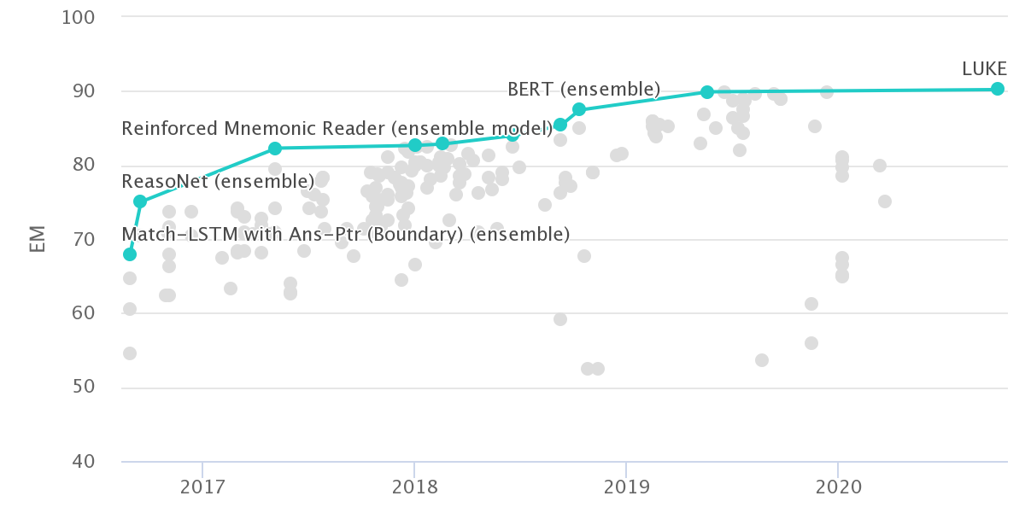
The Progress in NLP/QA
Many benchmarks in NLP:
SQuAD [Rajpurkar et al. 2016]
ARC [Clark et al. 2018]
DROP [Dua et al. 2019]
…
SQuAD leaderboard
Notes:
Similarly, in the past few years we have built many benchmarks for NLP.
And for each of these challenges, we have built systems that can achieve incredible performance.

Slide 6
Limits of Our Progress
Successes in NLP are focused on niche domains
QA Task
🤮
HotpotQA
Multi-hop reasoning
SQuAD
Predicate/argument structure
NarrativeQA
Narrative understanding
DROP
Arithmetic reasoning
Notes:
The downside is that all the major successes in NLP are focused on niche domains.
For example, if you build a model for SQuAD, it wouldn’t work on HotPotQA.
There is something odd about claiming that we (the community) are making progress in terms of “language understanding”, when the resulting models can’t simultaneously understand other reasoning problems (such as: numerical reasoning, compositional reasoning, etc.)
After all, all these are different, but relevant aspects of language understanding.

Slide 7
Breadth of tasks
language understanding problems
puzzles/search problems
SQuAD
HotPotQA
Go
Chess
Depth of tasks
Notes:
Let me show the same point pictorially:
Think of this light blue shape as the space of all the problems we’re interested in.
The X-axis is the collection of problem definitions, or the metaphorical breadth of problems.
For example, problem definitions for Go, for SQuAD, or any other QA task.
The depth is the complexity of each problem space.
For example, within the domain defined by the rules of Go.
Similarly, for any NLP task.
The issue I am alarmed by is that we excessively focus on depth,
We try to make the most sophisticated Go player
Similarly, for NLP models, we try to make the strongest models (for each dataset)
But very little time is spent in the breadth, i.e., building models that support a border range of tasks (i.e., more breads).

Slide 8
This Talk
In the current state of NLP field, we do not focus enough on the “breadth” of our progress.
Transfer Across Formats
Decomposing Complex Questions
Broadening scope of QA
Notes:
In this talk, I am advocating for more focus on the “breath” of our progress: We need to build models that cover a broader range of tasks.
And I am going to contextualize this broad idea with two recent work on question answering:
In the first part, I am going to talk about transfer between different QA formats.
Then in the 2nd part I am going to introduce a multi-hop reasoning system that generalizes two several existing datasets.
In terms of technical details, these two projects are accomplishing two different tasks. But they are united in that, they are different approaches to broadening the scope of QA.

Slide 9
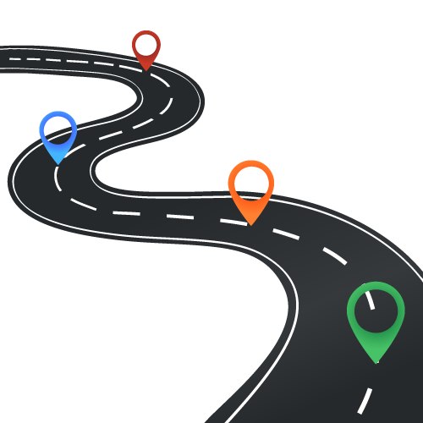
This Talk
▣ Introduction
▢ Transfer Across Formats
▢ Decomposing Complex Q’s
▢ Big Picture

Slide 10
Transfer Across QA Formats
K et al. UnifiedQA: Crossing Format Boundaries With a Single QA System. EMNLP-Findings 2020.

Slide 11
Many Flavors of QA
…
…
OBQA
BoolQ
NarQA
DROP
SQuAD1
SQuAD 2
ComQA
…
TREC-8
TREC-9
TREC-2001-2005.
MCTest
RACE
ARC
WinoGrande
2000 2005 2010 2015 2020
Notes:
In recent years, the community has built many QA datasets.

Slide 12
Many Flavors of QA
…
…
OBQA
BoolQ
NarQA
DROP
SQuAD1
SQuAD 2
ComQA
…
TREC-8
TREC-9
TREC-2001-2005.
MCTest
RACE
ARC
WinoGrande
2000 2005 2010 2015 2020
Question: “At what speed did the turbine operate?”
“16,000 rpm”
Candidates: (Nikola_Tesla) On his 50th birthday in 1906, Tesla demonstrated his 200 horsepower (150 kilowatts) 16,000 rpm bladeless turbine. ...
[Rajpurkar et al. 2016]
Notes:
For example, the SQuAD dataset popularized the extractive format, where each question comes with an accompanying paragraph that is supposed to explicitly contain the answer to the question.

Slide 13
Many Flavors of QA
…
…
OBQA
BoolQ
NarQA
DROP
SQuAD1
SQuAD 2
ComQA
…
TREC-8
TREC-9
TREC-2001-2005.
MCTest
RACE
ARC
WinoGrande
2000 2005 2010 2015 2020
Question: “What does photosynthesis produce that helps plants grow? ”
“The big kid”
Candidates: (A) water (B) oxygen (C) protein (D) sugar
[Clark et al. 2018]
Notes:
Multiple-choice questions should be a a familiar variant of QA to us;
A question is supplemented with a bunch of candidate answers

Slide 14
Many Flavors of QA
…
…
OBQA
BoolQ
Motivations for publishing new datasets:
Unexplored reasoning challenges
Alternate (better?) evaluation protocols
NarQA
DROP
SQuAD1
SQuAD 2
ComQA
…
TREC-8
TREC-9
TREC-2001-2005.
MCTest
RACE
ARC
WinoGrande
2000 2005 2010 2015 2020
But inherently they’re all QA!
Notes:
Essentially, each new dataset offers an alternate (better?) evaluation protocol for a slightly different phenomenon.
But inherently, they’re different realization of the same task (namely, QA).

Slide 15
Format-Specific Model Design
Consequences of format-specific designs:
Prevent generalization across formats
Don’t benefit from labeled data of other formats
Input
Task-specific layer
format | assumption
Yes/No QA
Multiple-choice QA
Extractive QA
Abstractive QA
binary output
One correct answer from a list of candidates.
answer is a substring of paragraph
answer to be inferred from the paragraph
Dataset-specific assumptions 😢
Notes:
Somehow the field has become “dataset” driven:
And consequently, we (the community) accepted that it is okay to encode dataset-specific assumptions into models.
For example: people who solve yes/no datasets (read)
We (the community) frequently exploit these assumptions that move our models away from the broad definition of QA.
And there are consequence to such narrow designs;
Format-specific assumptions create hard barriers for generalization of systems across formats.
A system engineered for YN cannot run on SQuAD questions.
Additionally, there is a missed opportunity here; as I will show later; by making QA systems more general we can build stronger models, partly because we can access a larger pool of data for supervision.

Slide 16
Format-Specific Model Design (2)
ExtractiveQA
Question: “At what speed did the turbine operate?”
(Nikola_Tesla) On his 50th birthday in 1906, Tesla demonstrated his 200 horsepower (150 kilowatts) 16,000 rpm bladeless turbine. …
“16,000 rpm”
MultipleChoiceQA
Question: “What does photosynthesis produce that helps plants grow?”
(A) water (B) oxygen (C) protein (D) sugar
“sugar”
Notes:
Just to say the same thing with a bit more graphics:
Within the boundaries defined by each of the QA formats, we have seen lots of activities.
My argument is that such boundaries, in many cases, are artificial and perhaps unnecessary, given that there is a lot of sharedness among the these tasks. So we’re gonna try to tear down these walls.

Slide 17
Beyond Format-Specialized Models
ExtractiveQA
Question: “At what speed did the turbine operate?”
(Nikola_Tesla) On his 50th birthday in 1906, Tesla demonstrated his 200 horsepower (150 kilowatts) 16,000 rpm bladeless turbine. …
“16,000 rpm”
MultipleChoiceQA
Question: “What does photosynthesis produce that helps plants grow?”
(A) water (B) oxygen (C) protein (D) sugar
“sugar”
Notes:
Enabled by this intuition, we built a system that performs surprisingly well across four different QA formats.

Slide 18
UnifiedQA: Definition
It’s a single system that is supposed to work on a variety of QA formats.
The input should be natural.
Minimal-enough for a human solver to infer the format.
What causes sound?
(A) sunlight (B) vibrations (C) x-rays (D) pitch
“vibrations”
Notes:
Let’s start with the high-level definition of the system I have in mind.
It’s a single system that is supposed to work on a variety of QA formats.
The input should be naturally readable; basically humans should be able to answer each format by just reading the input.
Let's see an example.
(read it)
Humans don't need to be told that this is a multiple-choice question. You just read it and infer it.
And that's what I expect a system to be able to do, as well.

Slide 19
UnifiedQA: Definition
It’s a single system that is supposed to work on a variety of QA formats.
The input should be natural.
Minimal-enough for a human solver to infer the format.
Is Jamaica considered part of the United States?
(Jamaica) Jamaica (/dʒəˈmeɪkə/ ( listen)) is an island country situated in the Caribbean Sea...
“no”
Notes:
Here is another example,
(read it)
Again, humans don't need to be told that it is yes/no question. They can infer it from the input.

Slide 20
UnifiedQA: Definition
It’s a single system that is supposed to work on a variety of QA formats.
The input should be natural.
Minimal-enough for a human solver to infer the format.
Use text-to-text architectures: T5 [Raffal et al. 2020], BART [Lewis et al. 2019], etc.
Our encoding:
Text-in, text-out
The question always comes first.
Additional info are appended with “\n”.
What type of musical instruments did the Yuan bring to China?
(Yuan_dynasty) Western musical instruments were introduced to enrich Chinese performing arts....
“Western musical instruments”
Notes:
Here is another one:
(read)
Again you don't need to know what is the format or the dataset. But one can infer it from what is shown as input.
Overall, all these examples illustrate our encoding of the instances when we feed them to the models.
(read)
Let me emphasize that: In this encoding, we never explicitly mention the format of a given instance or what dataset it belongs to. It is something that needs to be inferred.
The key technical requisite that we’re borrowing from the field is text-to-text architectures, such as T5, BART

Slide 21
Experiment: Mixing Pairs of Formats
Is there any value in out-of-format training?
70
65
60
55
50
Mixing RACE (Multiple-Choice) w/ datasets of different formats.
69.4
62.5
59.1
Trained on RACE
55.8
Trained on RACE + SQuAD 1
RACE
MCTest
[Lai et al. 17]
[Richardson et al. 15]
Notes:
The first intuition that one needs to verify is whether there is any value in mixing pairs of datasets.
(read the plots)
I don’t know about you, but when I was seeing these improvements, my first instinct was that there must be a bug somewhere.
Quite surprising how one can gain so much by creating these seemingly odd combinations.
--> more experiments in the paper Overall, empirically we see that there exists pairs of datasets with different formats that benefit from each other.
This brings us to the question of what happens when you mix multiple datasets of different format?

Slide 22
UnifiedQA-v1
Trained on the union of different formats:
Extractive: SQuAD 1.1, SQuAD 2.0
Abstractive: NarrativeQA
Multiple-choice: RACE, ARC, OBQA, MCTest
YesNo: BoolQ
* Rajpurkar et al. ‘16 & ‘18; Kociský et al. ‘18; Lai et al. ‘17; Clark et al. ‘18; Mihaylov et al. ‘18; Richardson et al. ‘13; Clark et al. ‘19
Notes:
Motivated by the previous observations, we build systems trained on a mix of many formats.
We build UnifiedQA, by training our models on the union of the following 8 datasets.
For the rest of this section, I am going to show several empirical intuitions on UQA.

Slide 23
Experiment: Comparison w/ Dedicated Models
Is UnifiedQA as good as systems dedicated to individual datasets?
UnifiedQA performs almost as well as individual T5 models targeted to each dataset.
Notes:
Is UQA as good as dedicated systems trained for individual datasets?
In this plot,
The BLUE bars belong to UQA (a single system for multiple datasets of different formats).
The GREEN bars are dataset-specific models; i.e., models that are evaluated on the same dataset that they were trained on.
The results show that UQA performs almost as well as targeted models.
On average (the right columns) UQA clearly outperforms dataset/format-specific systems.
Overall, UQA offers flexibility across multiple QA formats while compromising almost none compared to dataset-specific experts.

Slide 24
Experiment: Fine-tuning UnifiedQA
Is there value in using UnifiedQA as a starting point for fine-tuning?
Show SOTA on 10 datasets (OBQA, QASC, RACE, WinoGrande, PIQA, SIQA, ROPES)
Similar trends for BART
85
75
65
87
84
78
79
78
Fine-tuned on T5
70
Fine-tuned UnifiedQA (based on T5)
ARC-chall
CommonsenseQA
OBQA
[Clark et al. 18] [Talmor et al. 19] [Khot et al. 19]
Notes:
What if we only care about a particular benchmark?
is there a value in using UQA as a starting point for fine-tuning?
as opposed to a fine-tuning vanilla language model that is not familiar with the QA task yet?
Here I am showing the results of fine-tuning two systems.
(read the plot)
We see that fine-tuning on UQA consistently dominates fine-tuning on T5.
Intuitively, since UQA has had exposure to different formats, it is well-positioned to achieve higher scores after a little fine-tuning.
This is especially effective when a user has limited training data for their target QA task
We have an extensive experiments on this if you look at our paper, where we report SOTA scores on 10 dataset.
There are other experiments that I am not going to show due to my limited time:

Slide 25
Earlier Work on Multi-task Learning
In the same spirit as multi-task learning
They usually don’t work! 😭
The choice of tasks is also important.
Earlier works select too broad of tasks.
E.g., [Raffel et al.’19]: diverse NLP tasks (machine translation, summarization, etc) and conclude that a single model for multiple NLP tasks underperform task-specific models.
We choose to stay within the boundaries of QA.
[Caruana '97; McCann et al. ’18]
Didn’t work before; why would it work now? 🤔
Notes:
Before I end, I’ll mention a few words on transfer learning or multi-task learning:
There is a large body of work in this direction that try to exploit the commonalities of the tasks.
My understanding is that the majority of the efforts on multi-task learning don't result in any meaningful gains.
Here you might say, well it seems like you're also doing multi-task learning as well; it didn't for others, why do you think it works for you?
Here is my argument: In most cases, the failure of a multi-task learning (or their success, for that matter) should not be blamed on the algorithms, but rather on the choices of the tasks.
Many works often select an excessively broad set of tasks.
Raffel et al. (2019) experiment with diverse NLP tasks (machine translation, summarization, etc) that have very little in common.
Here, we choose our tasks so that we stay within the boundaries of QA and show that transfer across different QA variants is indeed possible.
That is really the key difference that enables us to show transfer in this study.

Slide 26
Lessons
The field relies excessively on format-specific assumptions for system design.
Creating format-specific QA models distance us from broad QA.
Instead, we should build more general QA architectures → more breadth!
Incentive: there is value in mixing QA datasets of different formats.
UnifiedQA: a single QA system working across four common QA formats
Fine-tuning models pre-trained on UnifiedQA yields SOTA results.
https://github.com/allenai/unifiedqa
Notes:
The field relies excessively on format-specific assumptions for system design. Instead, we should move towards more general QA architectures and push for broader scopes for QA systems.
There is incentive in doing so as well: we showed gains from mixing QA datasets of different formats.
And the by-product of the study is: UnifiedQA, a single pre-trained QA system that works across four common QA formats.

Slide 27
Decomposing Complex Questions in the Terms of Existing QA Models
KKRCS. Text Modular Networks: Learning to Decompose Tasks in the Language of Existing Models. NAACL 2021.

Slide 28

Generalization Across Multi-Hop Tasks
No system with a reasonable generalization across datasets! 😞
Complex QA Tasks
How many years did it take for the services sector to rebound?
What was the nationality of the director of "The Simpsons"?
DROP [Yang et al. 18]
HotpotQA [Dua et al. 19]
Challenge: How do we build a system that generalize to both datasets? 🤔
Hypothesis: despite having different distributions, their sub-problems are similar.
Idea:
Build a framework to decompose complex questions into simpler ones.
Have a shared set of solvers for addressing the sub-questions.
Notes:
In this part of the talk, I am going to focus on complex (multi-hop) QA problems, i.e., questions that require some form of reasoning. There are already a couple benchmarks for this task.
For instance, the DROP dataset, which contains questions like ... .
Another example is, the HotPotQA datasets, with questions like ...
For each of these datasets, the community has made tremendous progress in building dataset-specific models.
The leaderboards for each of these datasets are almost saturating.
However, after several years, we still do not have a single systems that works reasonably well on both datasets (the limited breadth.)
Partly because these dataset represent different distributions.
The challenge for us now is: how can we build a system that generalize to all these datasets at the same time.
Hypothesis: Even though these the questions of different distributions, their sub-problems are similar.
Idea:
build a general framework to decompose complex question into sub-questions
have a share set of systems to solve the sub-questions
Now let me try to detail how we're going to operationalize this intuition.

Slide 29
Key Idea: Shoulders of Giants
Input: complex question
Sub-Question Generator
Module₁
Module₂
….
Decomposes complex tasks into smaller tasks
Output: answer
Communication via natural language
Solved simple QA tasks
Text Modular Networks:
Modules for different skills
Natural language for communication between modules
ModularQA: an implementation of this framework
Notes:
Here is a high-level description of our proposed architecture:
A simple way to describe the idea here is: “standing on the shoulders of giants”.
The “giants” of our work are a bunch of models for simple and rich-resource tasks; for example, a SQuAD solver or a symbolic solver like a calculator. These models are good at what they’re designed for, but they’re essentially blind at solving problems that are slightly more complex.
The green box here (or next-question generator) its role is to break down a given complex question, decompose it into sub-questions and communicates them to appropriate modules.
A crucial issue here is that the communication between these components are done in natural language.
And in order for this language communication to be successful, the generated sub-questions need to be understandable to modules. (I am going to get back to it).
We call this general family of architectures Text Modular Network, since they consist of “modules” for different skills, and use natural language for the communication between its modules.
And I will present ModularQA as an implementation (instantiation) of Text Modular Networks.

Slide 30
ModularQA: Example
from DROP
Input: How many years did it take for the services sector to rebound?
In what years did the services sector rebound?
2003
SQuAD solver
Sub-Question Generator
When did the services sector take a hit?
2002
diff(2003, 2002)
Calculator
1
Output: 1
Immediate Benefit:
Ease of interpretation
Notes:
Let’s see an example of how this would work. ..
One immediate benefits that one can foresee from such architecture design:
Interpretability: we can see the reasoning chain used to get to an answer.

Slide 31
ModularQA: Example
Input: How many years did it take for the services sector to rebound?
In what years did the services sector rebound?
2003
SQuAD solver
Sub-Question Generator
When did the services sector take a hit?
2002
diff(2003, 2002)
Calculator
1
Output: 1
Challenge:
How do we build this model (that decomposes the complex tasks into simpler sub-tasks)?
Notes:
Challenges: well, it’s a non-trivial design. How would you go about building such an interactive system? That is the research/design question here.

Slide 32
Key Pieces to be Solved
Input: complex question
Module₁
Sub-Question Generator
?
Module₂
….
Output: answer
Design question: how to build a “sub-question generator”, s.t.:
The generated questions follow the “language” of existing QA sub-models (i.e., capabilities)
Notes:
The main component that we need to design is the sub-question generator which decompose a given complex questions into sub-questions.
And in doing so, our constraints is that:
The generated sub-questions should use the language of the modules.
So how would you build such a system?

Slide 33

A Naïve (?) Approach
Crowdsourcing approach for collecting question decomposition [Wolfson et al. 2020]
Costly human annotations
Not necessarily comprehensible to existing models
Shayne Graham
field goals of #1
yards of #2
number of #2 for each #3
#3 where #4 is two
“From what yard line did Shayne Graham kick two field goals?”
Notes:
The naive approach is: let’s create an annotated data for learning the decompositions.
There are already several works on that.
I argue that crowdsourcing decompositions is not a good idea.
it relies on human annotation which is costly.
The generated decompositions are not designed to be comprehensible by existing models.
So, what do we do then?

Slide 34
Approach: Noisy Decomposition
Given
noisy decompositions for supervision
Input: complex question
Module₁
Sub-Question Generator
Module₂
….
Output: answer
Given
SQuAD 2.0 (Roberta)
Calculator: x-y, 100-x, if-then-else
Notes:
Here is what we’re going to do:
- We are given pairs of input/outputs: complex questions and their answer (from DROP and HotPotQA datasets)
– We also fix our modules:
- SQuAD 2.0 model
- Symbolic function that can do difference, if-else, so on.
Now, everything is in BLUE is given.
What is not known is Sub-Question-generator.
- And in order to create that, we’re going to compile noisy supervision that we will use to supervise “sub-question generator”.
And that’s basically what I am going to show in the next few slides.

Slide 35

Step 1: Language of Existing QA Models
How can we build sub-questions that are understandable to the individual modules?
Train a model to generate the question
Labeled data for building modules
Suggested vocab to use in Q’s
The expected answer
Supplemented document
question generator
question answerer
QG(q_vocab, exp_ans, doc)
QG(
q_vocab=[“years”,“services”,“sector”],
exp_ans=2002,
doc=📄
)
When did the services sector take a hit?
When did the services sector take a downturn?
When did the services sector take a big hit?
....
In what years did the services sector rebound?
In what year did the services sector rebound?
….
2003
Notes:
The first piece of the puzzle is to define the language of the communication. Like I said, our model should decompose questions in a language that is understandable to the modules.
How can this be done?
We use the data that was used for building QA modules, to build Question-Generation systems
For example, if we’re going to use SQuAD solver as one of our modules, we build a QG system based on SQuAD data.
Essentially, the questions generated by this QG system are all understandable to the corresponding QA system.
Specifically, we build conditional generation models, conditioned on 3 main parameters
the suggested vocabulary to use in the generated questions
the expected answer of the generated questions
the context document from which we're gonna extract our questions
For instance, for the following choice of vocabulary, the expected answer & a doc (that I am not showing here), we might get the following questions
Now if I change the expected answer, …..
Such guided question generation is the key tool we will use to build noisy supervision for our question-decomposition.

Slide 36
Step 2: Typing Complex Questions
Infer the [complex] question type via heuristics
Question type | Example
Difference questions | How many years did it take for the services sector to rebound?
Comparison questions | Which ancestral group is smaller: Irish or Italian?
Complementation questions | How many percent of the national population does not live in Bangkok?
Composition questions | What was the nationality of the director of the "Little Big Girl" episode of "The Simpsons"?
Conjunction questions | Who is a politician and an actor?
👉
High-level and used across datasets
Notes:
Another piece of puzzle is labeling the complex questions with high-level types that describe the kind of reasoning used in them.
Here I am showing examples of our categories:
(read: comparison questions)
(read: conjunction questions)
The reason that we do this type-inference is because we will use it to form build noisy supervision for our question-decomposition model.
In practice, this inferring a complex question type is done using a relatively small set of rules.
I would emphasize that these heauristics are high level and are going to be used across multiple datasets.
To explain the idea, I am going to assume that we’re working with “difference” questions. The overall idea is similar for the rest of the question types.

Slide 37
Step 3: Generating [Noisy] Training Data
Form chains of sub-questions, based on the inferred type
Complex question and its answer:
Question: How many years did it take for the services sector to rebound?
Answer: 1
q_vocab=non-stop words from complex question
Question Type=difference
q1 = QG(q_vocab, exp_ans=n1, doc)
q2 = QG(q_vocab, exp_ans=n2, doc)
q3 = calc(diff, n1, n2)
n1 and n2: numbers extracted from doc with difference equal to the final answer.
Notes:
Then, we form a decomposition that is specific to the inferred type.
For example, for a question of type “difference”, the decomposition program is as follows.
it consists of 3 sub-questions where:
the first two sub-questions are produced based QG system.
Here the suggested vocabulary to be used are the non-stop words from the original question
And n1/n2 are pair of numbers with difference equal to the answer of the complex question.
And the last sub-question is produced for the symbolic solver
This gives us many decomposition triplets for this question.

Slide 38
Step 4: Filtering the [Noisy] Training Data
Filter out undesirable chains:
Too many question words not used
Too many new words introduced
Complex question and its answer:
Question: How many years did it take for the services sector to rebound?
Answer: 1
Question Type=difference
q1 = QG(q_vocab, exp_ans=n1, doc)
q2 = QG(q_vocab, exp_ans=n2, doc)
q3 = calc(diff, n1, n2)
Filtering
noisy chains
Notes:
And lastly, we filter out the undesirable chains.
Essentially, we eliminate any chain that
- fails to cover the vocabulary of the complex questions
- introduces too many new vocabulary
This concludes our process of extracting sub-question chains.

Slide 39
Training the Model
Train the model to generate future sub-questions, given the past ones.
Q: How many years did it take for the services sector to rebound?
Q1: In what years did the services sector rebound?
Q: How many years did it take for the services sector to rebound?
Q1: In what years did the services sector rebound?
A1: 2003
Sub-Question Generator
Q2: When did the services sector start to take a dip?
Q: How many years did it take for the services sector to rebound?
Q1: In what years did the services sector rebound?
A1: 2003
Q2: When did the services sector start to take a dip?
A2: 2002
Q3: Calc[diff, 2002, 2003] ■
Notes:
And the final stop is using the collected decompositions to train our system.
We train the decomposer to generate future sub-questions, given the past sub-questions.
For example, ….

Slide 40
Training the Model
Train the model to generate future sub-questions, given the past ones.
Q: How many years did it take for the services sector to rebound?
Sub-Question Generator
Q1: In what years did the services sector rebound?
Q: How many years did it take for the services sector to rebound?
Q1: In what years did the services sector rebound?
A1: 2003
Sub-Question Generator
Q2: When did the services sector start to take a dip?
Q: How many years did it take for the services sector to rebound?
Q1: In what years did the services sector rebound?
A1: 2003
Q2: When did the services sector start to take a dip?
A2: 2002
Sub-Question Generator
Q3: Calc[diff, 2002, 2003] ■
Notes:
And the final stop is using the collected decompositions to train our system.
We train the decomposer to generate future sub-questions, given the past sub-questions.
For example, ….

Slide 41
ModularQA System
Uses BART-Large for sub-question generation
QA modules
Roberta model trained on SQuAD 2.0
Math Calculator with three key functions: x-y, 100-x, if-then-else
Target datasets:
DROP [Dua et al. 19]
HotPotQA [Yang et al. 18]
Notes:
We built ModularQA in this fashion.
We use the BART model as our sub-question generation model.
In terms of our modules, we have two:
RoBERTa trained on SQuAD 2.0
Symbolic solver, which can perform three operations: x-y, 100-x, if-then-else.
The way this symbolic solver is incorporated is quite similar to the squad solver. I am not going to talk about it’s details since our time would not permit it. Happy to elaborate more in another time.
Target datasets:
To evaluate our modular approach, we use two datasets, DROP and HotpotQA, both of which contain compositional questions.
And both of them contain questions answerable using our two modules: SQuAD model and a symbolic calculator.

Slide 42
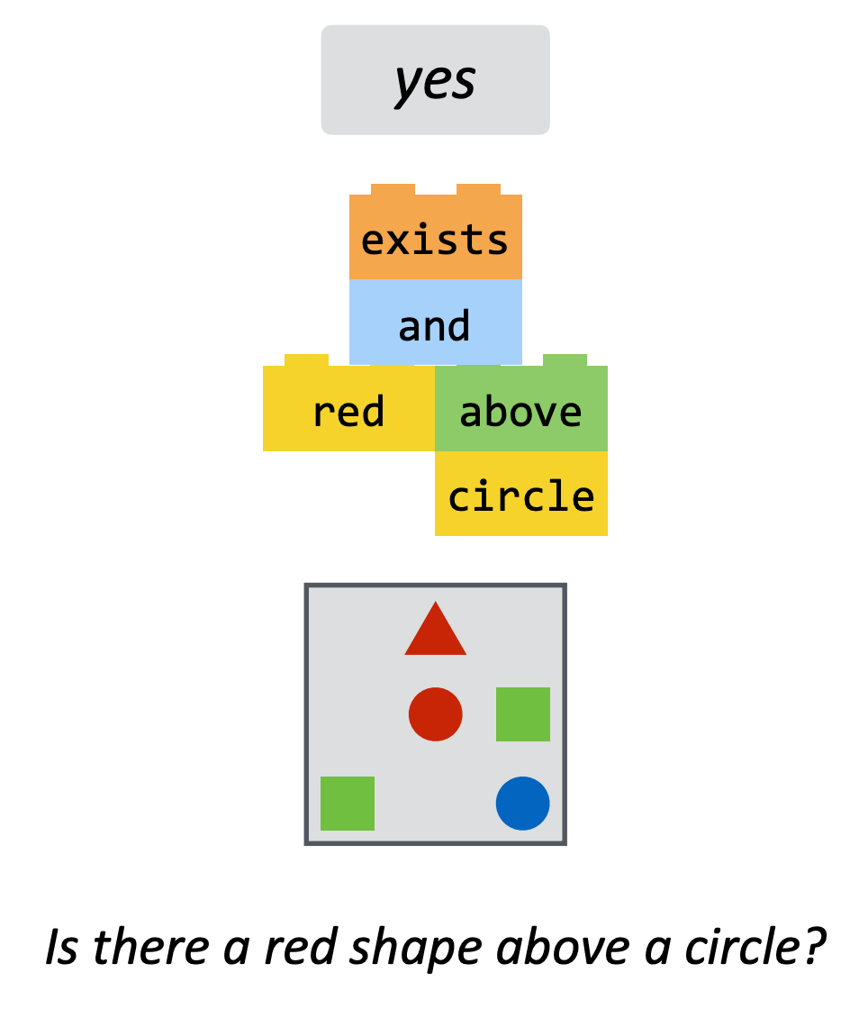
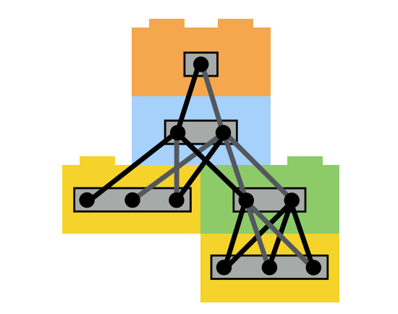
Existing Modular Architectures
Neural Module Networks [Andreas et al. 16]
Communicate through dense vectors
(e.g., attention weights)
Notes:
Before I show our empirical results, a few words about relevant works:
Various modular architectures have been proposed to exploit compositionality:
The most relevant one is neural module networks:
consists of task-specific neural modules.
Unlike Text Modular Networks that use natural language for communication, NMNs communicate through dense vectors (e.g., attention weights) which are less explainable.

Slide 43
Experiment: Comparison w/ Existing Models
ModularQA is competitive with other modular approaches
while producing textual explanations (rather than attention weights)
Performs not far from black-box models that use dataset specific assumptions
Interpretable model w/ competitive on DROP and HotpotQA
System | Evaluated on
 | DROP (F1) | HotPotQA (F1)
NMN-D [Gupta et al. 20] | 79.1 | ?
S-NMN [Jiang and Bansal. 19] | ? | 63.1
NumNet+V2 [Ran et al. 19] | 91.6 | ?
Quark [Groeneveld et al. 20] | ? | 75.5
ModularQA [this work] | 87.9 | 61.8
modular baselines
black-box baselines
Notes:
Here is an evaluation of several systems on our target datasets.
Each row is a single system.
First, two Neural Module Networks, with modules designed specifically for DROP (Gupta et al., 2020) and for HotpotQA (Jiang and Bansal, 2019).
MODULARQA actually substantially outperforms the DROP model NMN-D while being able to produce textual explanations (rather than attention weights)
On the HotpotQA dataset, MODULARQA is comparable to S-NMN
Additional experiments that are not shown here:
Higher Robustness
Learning with Less Data
#### Quark relies on supporting fact annotation and 542 trains a single end-to-end QA model, thereby being more likely to exploit dataset artifacts
## Making the work other datasets: All of them would require a non-trivial amount of work to be applicable to a different dataset. The amount of work varies and I am not sure about the threshold of “inherent design constraint”

Slide 44
Lessons
Text Modular Networks, a general-purpose framework
Complex tasks solved as textual interaction between existing modules
ModularQA, an insanitation of this framework
Benefits:
First interpretable model for DROP and HotpotQA → more breadth!
Competitive with existing approaches
Notes:
We introduced Text Modular Networks: a general-purpose framework for solving complex questions.
Based on this conceptual framework, we built ModularQA.
Empirically, ModularQA is competitive with other modular approaches, while providing easy-to-interpret explanations of its reasoning.

Slide 45
Tying the Loose Ends
Currently, we do not focus enough on the “breadth” of our progress.
Obsessed with “depth” (e.g., chasing leaderboards for individual tasks)
The two works presented here:
UnifiedQA: broader range of tasks
ModularQA: utilizing existing modules for more complex tasks
Depth
Breadth
Notes:
Let me circle back my introduction and remind you about the big picture.
Like I argued, in the current state of NLP field, we do not focus enough “breadth” of our progress,
we’re obsessed with depth (e.g., chasing leaderboards for individual datasets).
The two works that I presented here are different ways of expanding the scope of our systems.
In the first section, I talked about models that can address a broader range of tasks.
In the 2nd section, I introduced a framework to build a single system that generalizes to two different multi-hop datasets.
I would emphasize that these are not just two systems:
Initial steps towards a broader view of machine comprehension system design.

Slide 46
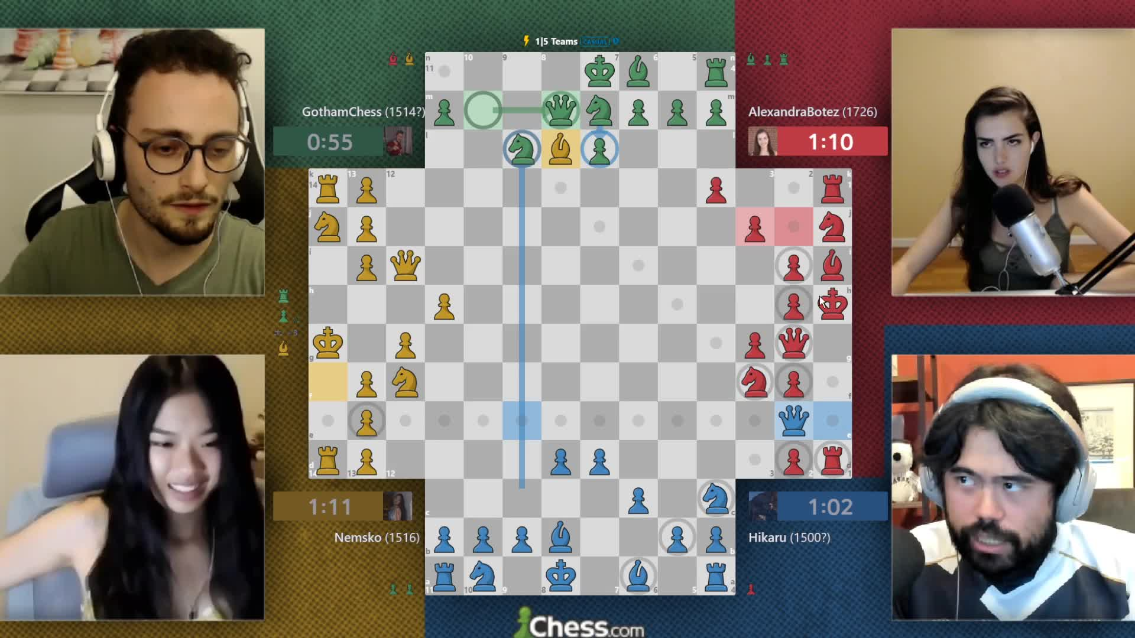
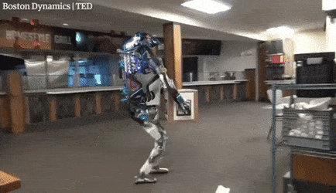
Hurdles Towards “Breadth”
Humans are bad with “depths”!
Difficult to master tasks
Good with mixing problems
Computers are the opposite!
Notes:
Now, why making progress towards “breadth” has been difficult?
Part of the reason, in my opinion, is because "depth" is Human's weakness.
it’s difficult for us to master individual problems (say Chess: I’ve been practicing my chess for the past year or so, I still suck),
however, we (humans) are really good at context switching and mixing problems.
This is a screenshot of few famous chess players streaming their 4-person chess.
To play 4-person chess, you just need to know the same rules of the usual 2-player chess; you don’t need to know any other rules, you don’t need additional training.
Humans have no difficulty generalizing from 2-player chess t o 4-player chess, eventhough they have different boards.
Computers have the opposite weakness: they’re good at depth (it’s easy for us to make fantastic Chess players), but it’s difficult to build systems that can do mix-and-match between tasks.
Say, a system that can generalize to other variants of chess, only by knowing 2-player chess.
say, a squad-solving chess player system that can also give you financial advice.
And because we the researchers are humans, by design we’re bad at thinking about what is a good challenge for computers. → something to be careful about.
########
You might have noticed that I did not mention “generalization” throughout the presentation
Here is your text-book definition for “generalization”: ….
But what is “unobserved inputs”? What qualifies for unobserved? (“unobserved” along what axis?)
My beef with our current notions of ”generalization” is that it does not capture the difference between ”depth” and “breadth”.
How can we modify it to account for both depth and breadth?
These are the research questions that I hope we can address in the coming few years.

Slide 47
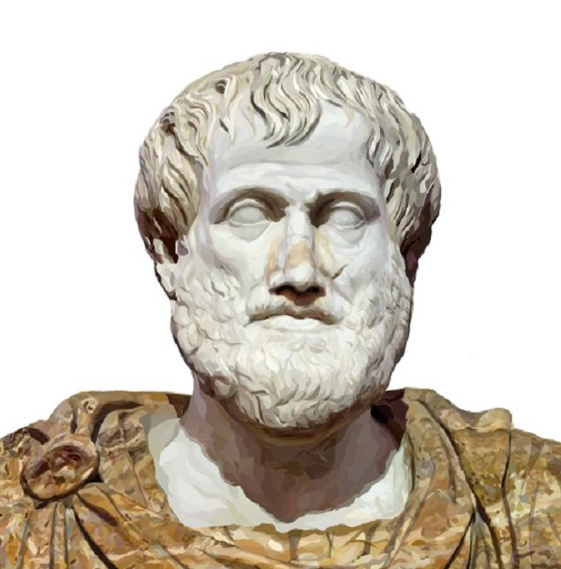
A Challenge Dataset for Implicit Composition
Lived not that long ago!
An average human has no difficulty lifting objects
Did Aristotle Use a Laptop?
Was Aristotle able to carry an object as heavy as a laptop?
StrategyQA [Geva et al. TACL’21]
Notes:
Before I end, let me spotlight a related challenge dataset we recently released challenge for QA.
Obviously, building challenge datasets is important aspect our field today since this way incentivize the field to address harder problems.
in our recent work, we focus on compositional QA where the compositions are “implicit”.
Consider this example: “Did Aristotle have a laptop?”
The answer obviously is a “no”: Because as know Aristotle lived a long time ago, when laptops were not invented.
But what made us reason this way. After all, there is no mention of time in the statement of the question.
I can easily ask many other questions about Aristotle that does not involve time. For example ….
In a nutshell, we know so many attributes about Aristotle: and somehow humans know what attribute is needed to form an appropriate reasoning. But that’s not so trivial for machines.
That’s the challenge defined in the StrategyQA dataset, where the questions involve implicit decompositions.
If you're working on QA and wanna play with a new datasets, please take a look at our work!
##################
And by introducing this challenge, we’re hoping to drive the research towards the models that do not just train on a single dataset, but those that address a broader a range of skills.
Before I end, let me spotlight a related challenge dataset we recently released for QA,.
Let me try to explain the idea here, with several questions from the dataset:
“Did Aristotle have a laptop?”
The answer obviously is a “no”, because as know Aristotle lived a long time ago.
- Average human has no difficulty lifting objects
- ancient Greece had hot summers and mild winters
That’s the challenge defined in the StrategyQA dataset, where the questions involve implicit decompositions.
And by introducing this challenge, we’re hoping to drive the research towards the models that do not just train on a single dataset, but those that address a broader a range of skills.
# I spend quite a bit of my time on evaluation of models, for example by building challenge datasets.
# This is important since this way incentivize the field to address harder problems.

Slide 48
That’s it!
Notes:
That’s all I had, I appreciate your time and attention.

Slide 49
Progress Towards “Breadth”
Humans are bad with “depths”!
Computers are the opposite!
Our progress needs a more refined definition for “generalization”!
“The ability to perform well on previously unobserved inputs is called generalization.” [Deep Learning, Goodfellow et al. , 2015]
Notes:
Now, why making progress towards “breadth” has been difficult?
Part of the reason, in my opinion, is because Humans are bad with depths
it’s difficult for us to master individual problems (say Chess: I’ve been practicing my chess for the past year or so, I still suck),
however, we (humans) are really good at context switching and mixing problems.
This is a screenshot of few famous chess players streaming their 4-person chess.
To play 4-person chess, you just need to know the same rules of the usual 2-player chess; you don’t need to know any other rules, you don’t need additional training.
Humans have no difficulty generalizing from 2-player chess t o 4-player chess, eventhough they have different boards.
Computers have the opposite weakness: they’re good at depth (it’s easy for us to make fantastic Chess players), but it’s difficult to build systems that can do mix-and-match between tasks:
Say, a system that can generalize to other variants of chess, only by knowing 2-player chess.
say, a squad-solving chess player system that can also give you financial advice.
And because we the researchers are humans, by design bad at thinking about what is a good challenge for computers. → something to be careful about.
You might have noticed that I did not mention “generalization” throughout the presentation
Here is your text-book definition for “generalization”: ….
But what is “unobserved inputs”? What qualifies for unobserved? (“unobserved” along what axis?)
My beef with our current notions of ”generalization” is that it does not capture the difference between ”depth” and “breadth”.
How can we modify it to account for both depth and breadth?
These are the research questions that I hope we can address in the coming few years.

Slide 50
Progress Towards “Breadth”
Humans are bad with “depths”!
Computers have the opposite problem!
Need a refined definition for “generalization”!
“The ability to perform well on previously unobserved inputs is called generalization.” [Deep Learning, Goodfellow et al. , 2015]
Notes:
Part of the reason behind this obsessions is because Humans are bad with depths
it’s difficult for us to master individual problems (say Chess: I’ve been practicing my chess for the past year or so, I still suck),
however, we (humans) are really good at context switching and mixing problems.
Computers have the opposite weakness: they’re good at depth (it’s easy for us to make fantastic Chess players), but it’s difficult to build systems that can do mix-and-match between tasks: say, a squad-solving chess player system that can also give you financial advice.
We researchers (as human beings), are by design bad at thinking about what is a good challenge for computers. → something to be careful about.
You might have noticed that I did not mention “generalization” throughout the presentation
Here is your text-book definition for “generalization”: ….
My beef with our current notions of ”generalization” is that it does not capture the difference between ”depth” and “breadth”.
But what is “unobserved inputs”? What qualifies for unobserved? (“unobserved” along what axis?)
How can we modify it to account for both depth and breadth?
These are the research questions that I hope we can address in the coming few years.

Slide 51
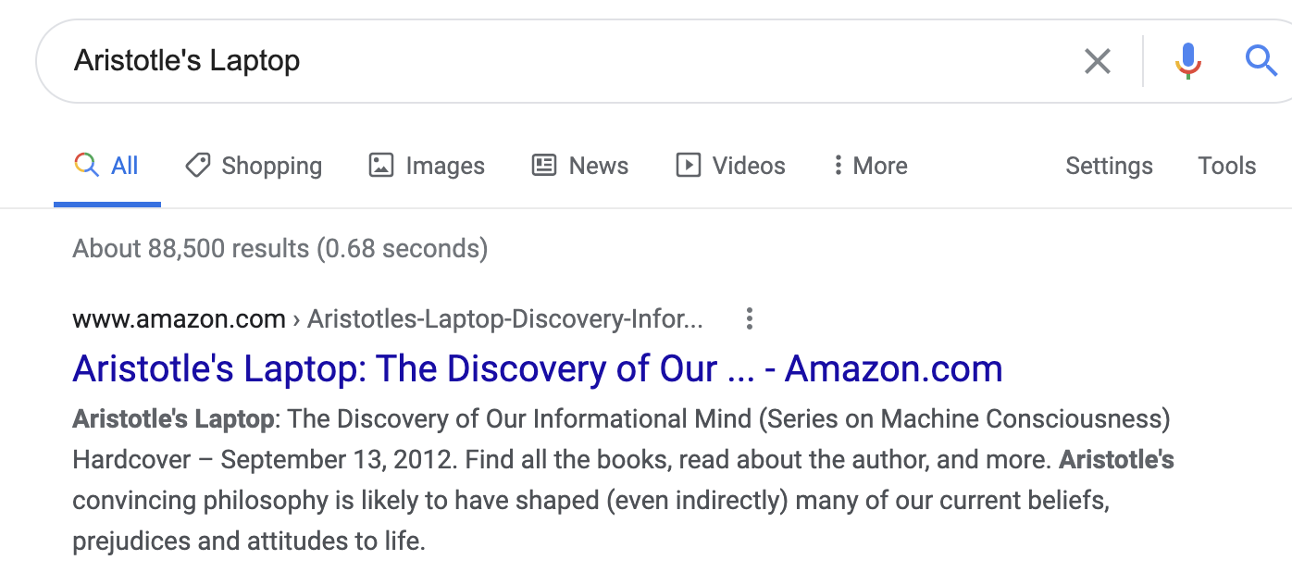
Implicit Composition
Lived a long time ago!
Was a human
Lived not that long ago!
Lived in Greece
Did Aristotle Use a Laptop?
Did Neanderthals know about Aristotle’s ideas?
Did Aristotle have the power to lift an object as heavy as a laptop?
Would Aristotle have preferred a warm coat over a short-sleeved shirt?
StrategyQA [Geva et al. TACL’21]
Notes:
I am going to end by spotlighting a recent challenge dataset we built for QA, where the questions involve implicit decompositions.
Let me try to explain the idea here, with several examples:
“Did Aristotle have a laptop?”
The answer obviously is a “no”, because as know Aristotle lived a long time ago.
“”:
B
That’s the challenge defined in the StrategyQA dataset.
- Average human has no difficulty lifting objects
- ancient Greece had hot summers and mild winters
I spend quite a bit of my time on evaluation of models, for example by building challenge datasets.
This is important since this way incentivize the field to address harder problems.

Slide 52
Better Systems
Continue towards broader scope for QA models
Broadness: how to cover a larger range of “natural” variations of QA?
Reliability: we can we quantify what model [un]certainty?
Faithful Explainability: can we get explanations that are faithful to models’ reasoning?
Efficiency: Can we build small, yet accurate models?
Depth
Breadth
Notes:
… knowing that Google has many applications that are QA-like, I know all of these attributes are of interest for Google.

Slide 53
Big Picture & Look Ahead
Notes:
… very briefly I am going mention my other experiences.

Slide 54
Look Ahead
Notes:
Briefly, about future directions:

Slide 55
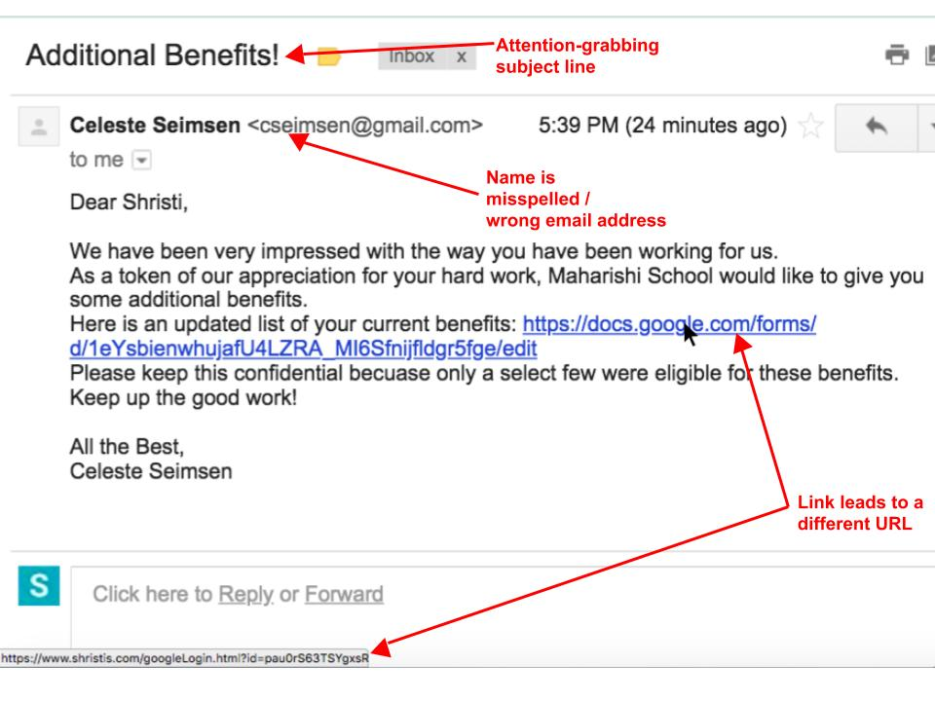
Learning from Instructions
Input-output supervision
instructions
Notes:
The landscape of NLP is dominated by single-input, single-output supervision for fixed tasks.
But now that we have saturated many individual tasks, we should move to higher abstractions of tasks.
One such abstraction that I am interested in is: task descriptions. Can we just “describe” (in plain language) a certain desired behavior?
Benefits:
more flexible that imitating input-output datasets
would save lots of money that typically put into building input/output datasets
There are many tasks that are difficult to be formulated as datasets → outlier behaviors (distribution tail) e.g., someone’s allergy to a certain food.
With all the advances in building stronger language-models (T5, GPT3, etc), I think there is a lot that we can do here.
Such a flexible NLP model design could be quite beneficial for Google.

Slide 56
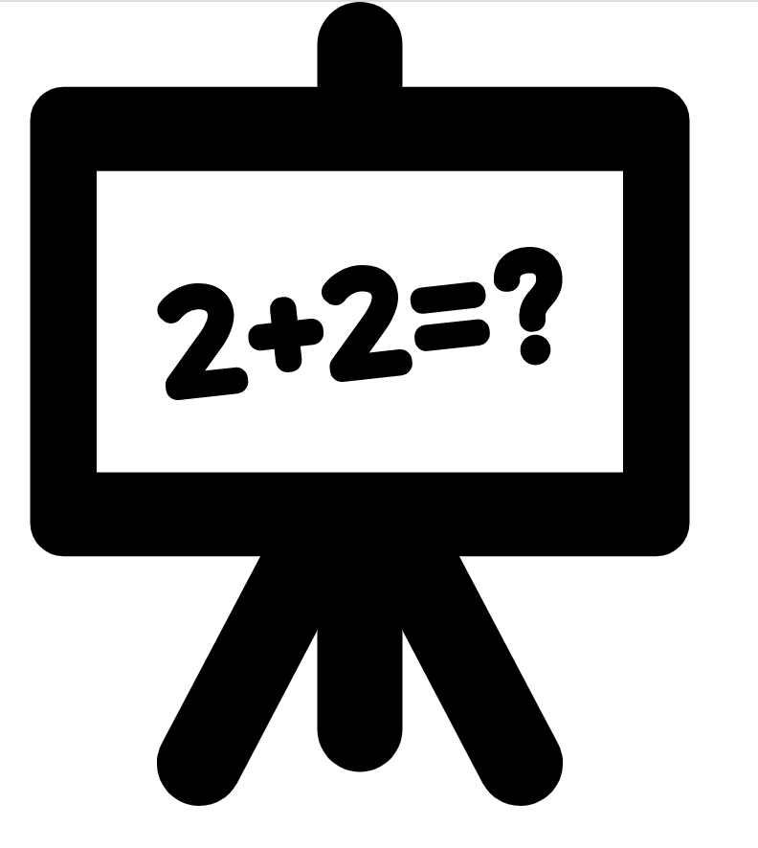


Interactive Semantics
Single-shot evaluation
input problem
evaluation
Learning from interactions
Notes:
The dominant setup in nlp is “single shot” evaluation: given an input instance, a model needs to predict an output on which its accuracy is judged.
People, however, do not communicate in this manner.
Humans interact; there is often back and forth.
This interaction helps humans resolve errors, resolve differences and learn from each other.
I believe we should also move towards such ideas in NLP as well.
I think applications like Google Assistant are very natural testbed for “interactive semantics”.

Slide 57
Demos
https://unifiedqa.apps.allenai.org
https://modularqa-demo.apps.allenai.org

Slide 58
QA datasets
…
OBQA
BoolQ
NarQA
DROP
SQuAD1
SQuAD 2.0
ComQA
…
TREC-8
TREC-9
TREC-2001-2005.
MCTest
RACE
ARC
WinoGrande
2000 2005 2010 2015 2020
Question: “Who was Billy?”
Passage: “Billy was like a king on the school yard. A king without a queen. He was the biggest kid in our grade, so he made all the rules during recess. ... Candidates: (A) The skinny kid (B) A teacher (C) A little kid (D) The big kid
“The big kid”
Notes:
Here is another format you’re familiar with: multiple-choice QA, where the question comes with a bunch of candidates.
(read the question) and the expected answer is one of these candidate answers.

Slide 59
QA datasets
…
OBQA
BoolQ
NarQA
DROP
SQuAD1
SQuAD 2.0
ComQA
…
TREC-8
TREC-9
TREC-2001-2005.
MCTest
RACE
ARC
WinoGrande
2000 2005 2010 2015 2020
Question: “What does a drink from narcissus's spring cause the drinker to do?”
“fall in love with themselves ”
Candidates: Mercury has awakened Echo, who weeps for Narcissus, and states that a drink from Narcissus's spring causes the drinkers to ``Grow dotingly enamored of themselves.'' ...

Slide 60
QA datasets
…
OBQA
BoolQ
NarQA
DROP
SQuAD1
SQuAD 2.0
ComQA
…
TREC-8
TREC-9
TREC-2001-2005.
MCTest
RACE
ARC
WinoGrande
2000 2005 2010 2015 2020
Question: “At what speed did the turbine operate?”
“16,000 rpm”
Candidates: (Nikola_Tesla) On his 50th birthday in 1906, Tesla demonstrated his 200 horsepower (150 kilowatts) 16,000 rpm bladeless turbine. ...

Slide 61
UnifiedQA: Towards an Implementation
Use text-to-text architectures
T5 [Raffal et al, 2020], BART [Lewis et al, 2019], etc.
Train simultaneously on all datasets.
Batches contains the same number of instances from each training set.
Notes:
The key technical requisite that we’re borrowing from the field is text-to-text architectures, such as T5, BART
We train the models on several dataset simultaneously (as opposed to training in a sequential manner).
### To make sure the model is uniformly exposed to all the datasets, we form batches that are expected to contain the same number of instances from each dataset, regardless of its size (sampling probability == inversely proportional to the size of the training data).

Slide 62
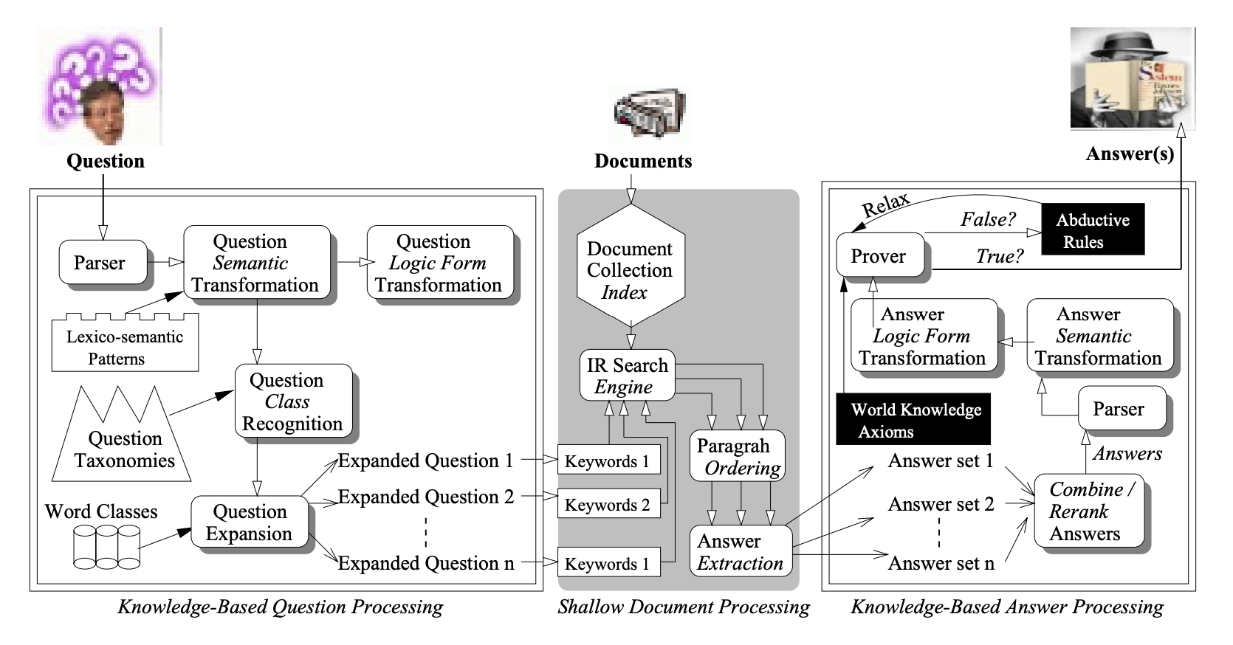
Our progress in QA: the good
More general language representations.
[Harabagiu et al, 2000; others]
Input
Task-specific layer
[Peters et al; Devlin et al; others]
Notes:
With respect to our progress in the field, one point that many of us would probably agree is the generality of the representation techniques today.
On the right you see a picture from QA paper of 20 years ago. You can see sorts of specialized models (parser, question type recognizer, world knowledge axioms, etc) that they had to use internally to build a representation for their QA model.
Now all that you have to do is to download your favorite muppet, feed it the input, and devise a task-specific output for it.

Slide 63
Intuition #2: Unseen Datasets
Does UnifiedQA generalizes well to unseen datasets?
On average, UnifiedQA shows much stronger generalization across a wide range of datasets.
evaluation sets
 | NewsQA | Quoref | DROP | DROP-CS | QASC | CommonsenseQA | NP-BoolQ | BoolQ-CS | Avg
UnifiedQA [EX] | 59 | 65 | 25 | 24 | 55 | 63 | 21 | 13 | 42
UnifiedQA [AB] | 58 | 68 | 31 | 37 | 54 | 59 | 27 | 40 | 48
UnifiedQA [MC] | 48 | 68 | 29 | 37 | 68 | 76 | 3 | 6 | 44
UnifiedQA [YN] | 1 | 2 | 0 | 0 | 15 | 21 | 79 | 79 | 22
UnifiedQA | 59 | 63 | 33 | 40 | 68 | 76 | 81 | 80 | 62
models trained for individual formats
Notes:
We now explore whether UQA generalizes well to other, *unseen* datasets. Here is a table that summarizes the results of experiments where we evaluate various models on datasets that are not observed during training.
Each row is a model.
The first few rows shows T5 models trained for individual formats; (e.g., UQA [EX], built by training the model on only extractive datasets).
The last rows shows UQA (training on multiple formats)
Several observations here:
Single-format experts are better at generalization only when the source and target datasets are very similar (for instance SQuAD and Quoref)
Meanwhile, they do not generalize to unseen datasets of unseen formats;
which kinds of expected, but it goes to show the the importance of feeding a diverse questions, if you want it to function on broad QA.
Overall UnifiedQA shows a pretty generalization compared to the single-format models.
In several cases in fact, UQA shows a better generalization than single-format experts; e.g., DROP.
A point to highlight is that UnifiedQA is trained on multiple-choice questions with 4 candidate answers.
That being said, it works quite well on datasets with more than 4 candidate answers (QASC and CommonsenseQA have has 8 and 5 candidate answers per question, respectively).
On average (last column), UNIFIEDQA shows much stronger generalization across a wide range of datasets.

Slide 64
Experiment: Mixing Pairs of Formats (2)
Is there any value in out-of-format training?
Mixing BoolQ (YesNo) w/ datasets of different formats.
80
70
60
50
X=SQuAD 1 (Extractive)
78.9
76.4
X=SQuAD 1 (Extractive)
66.0
X=NarQA (Abstractive)
64.1
Trained on BoolQ
61.0
53.4
Trained on BoolQ + X
BoolQ
BoolQ-CS
MultiRC (YN subset)
[Clark et al. 19] [Gardner et al. 20] [K et al. 18]
Notes:
Here is another experiment:
(read the plots)
Again, we see similar trends.
Overall, empirically we see that there exists pairs of datasets with different formats that benefit from each other.
This brings us to the question of what happens when you mix multiple datasets of different format?

Slide 65
Experiment: Comparison w/ Dedicated Models
Is UnifiedQA as good as systems dedicated to individual datasets?
UnifiedQA performs almost as good as individual T5 models targeted to each dataset.
evaluation sets
 | SQuAD2 | RACE | BoolQ | NarQA
T5 (SQuAD 2) | 91 | 33 | 12 | 51
T5 (RACE) | 43 | 87 | 7 | 54
T5 (BoolQ) | 4 | 22 | 90 | 0
T5 (NarQA) | 45 | 48 | 47 | 65
UnifiedQA | 90 | 87 | 90 | 65
Notes:
Is UQA as good as dedicated systems trained for individual datasets?
- The BLUE bars belong to UQA (a single system for multiple datasets of different formats).
- The GREEN bars are dataset-specific models; i.e, each bar belongs to each dataset.
The results show that UQA performs almost as good as individual T5 models targeted to each dataset. In some cases UQA performs even better than the single-dataset experts (e.g., on OBQA or NQA).
On average (the bars on the right side) UQA clearly outperforms the ensemble of dataset/format-specific systems.
(show the table)
Here is the subset of the same results in a tabular format.
- each row is a system.
- first few rows are dataset-specific systems.
- And the last row shows UQA.
- You can see that dataset-specific models are good, however, they don't generalize to other formats.
UQA thus offers flexibility across multiple QA formats while compromising almost nothing compared to dataset-specific experts.

Slide 66
Fine-tuning on UnifiedQA
Is there a value in using UnifiedQA as a starting point for fine-tuning?
65
55
45
35
70
66
64
63
55
Fine-tuned on BART
40
Fine-tuned UnifiedQA (based on BART)
OBQA
ARC-chall
CommonsenseQA
[Khot et al. 19] [Clark et al. 18] [Talmor et al. 19]
Notes:
Fine-tuning of pre-trained language models has become the standard paradigm for building datasetspecific stat-of-the-art systems. The question we address here is: when it comes to QA, is there a value in using UNIFIEDQA as a starting point for fine-tuning, as opposed to a vanilla language model that has not seen other QA datasets before?
Here I am showing the results of fine-tine two systems.
We see that fine-tuning on UNIFIEDQA consistently dominates fine-tuning on T5 and BART, respectively.
It also dominates the best previous scores on the datasets. Intuitively, since UNIFIEDQA has seen different formats, it should be positioned to achieve higher scores after a little fine-tuning, compared to fine-tuning on a vanilla T5 or BART model.
This could be especially effective when a user has limited training data for a target QA task This also highlights that the effectiveness of crossformat training is not limited only to T5, but is rather a general trend for text-to-text architectures.

Slide 67
Methodological Issue: Data Leakage
“have you done some studies on overlap across datasets?”
Easy answer:
not much surface-form overlap between the datasets.
Nuanced/ difficult answer:
more data (especially during pre-training) increases the chances of (indirect) leakage.
Notes:
I wanna address a common question that I get these days here;
And that is: (read)
This is a simple question, but surprisingly a tricky one to answer.
If we want to be a bit simplistic, here is the easy answer: On the surface level, there is not much overlap between the datasets, and hence there is no leakage. There is something really unsatisfactory about this answer …
Here is the correct (but the tricky) one: with more more (supervised on unsupervised) observations, the chances of leakage increases.
And this issue is not just particular to UnifiedQA;
Our models have already seen the answers to many of the questions somewhere on the internet, mostly during pre-training.
But the issue is: will the LM or UnifiedQA of today, work on questions of tomorrow; questions that we don’t necessarily know today.
I don't know how to go about studying myself, but I encourage everyone to think about it; we (as a community) need to better methodologies for evaluation of our real progress.

Slide 68
Talk Summary & Statement
Creating format-specific QA models distance us from broad QA.
There is overlap between underlying reasoning abilities of formats.
One can benefit from mixing QA formats.
UnifiedQA: a single QA system working across four common QA formats.
Fine-tuning models pre-trained on UnifiedQA yields SOTA results.
Notes:
- …hence, it is discouraged.
- The good news is that: there is …. [seemingly different]. …
since the reasoning is shared among formats, one can benefit from mixing different QA formats.
- We build based on these intuitions to create a model

Slide 69
Decompositions
What did the American writer who wrote Into Thin Air primarily known for in his writings
Q: Who wrote Into Thin Air? A: Jon Krakauer's
Q: What is Jon Krakauer primarily known for? A: his writings about the outdoors
Crucible is a geodemography computer system created by a company that has stores in how many countries?
Q: Crucible was created by what company? A: Tesco
Q: How many countries does Tesco have stores in? A: 12
The screenplay for Alain Resnais' second film is who?
Q: What is Alain Resnais' second film? A: Hiroshima mon amour
Q: Who is the screenplay for Hiroshima mon amour by? A: Marguerite Duras

Slide 70
How many months were there between the disclosure of Flash Version 3 and the introduction of MorphInk 99? Q: When was the introduction of MorphInk 99? A: February 1999 Q: When was Flash Version 3 disclosure? A: October 1998 Q: diff(February 1999, October 1998, months) A: 4
How many in percent weren't 45 to 64? Q: How many percent was 45 to 64? A: 20.1 Q: not(20.1) A: 79.9
who become the first Duke of franconia, the Würzburg bishops or kings of Bavaria ? Q: When did the Würzburg bishops become Duke of franconia? A: 1803 Q: When did the Bavarian kings become Duke of franconia? A: 1918 Q: if_then(1803 < 1918, the Würzburg bishops, kings of Bavaria) A: the Würzburg bishops
How many more exports does Indonesia export than Malaysia, in percent? Q: In percent, what does Indonesia export? A: 52.2 Q: What percent does Malaysia export in total? A: 37.9 Q: diff(52.2, 37.9) A: 14.3

Slide 71
Experiments
DROP
Three classes of questions within-scope: comparison, difference and negation
Others require span-list prediction sub-model or boolean QA sub-model
Trained and evaluated on within-scope questions (15K train)
HotpotQA
Trained on 15K “hard” examples.
Both bridge and comparison questions; distractor setting
Also has some out-of-scope comparison questions but harder to identify
E.g. Which person was in more bands?
Public dev dataset split into our own dev/test split on both

Slide 72
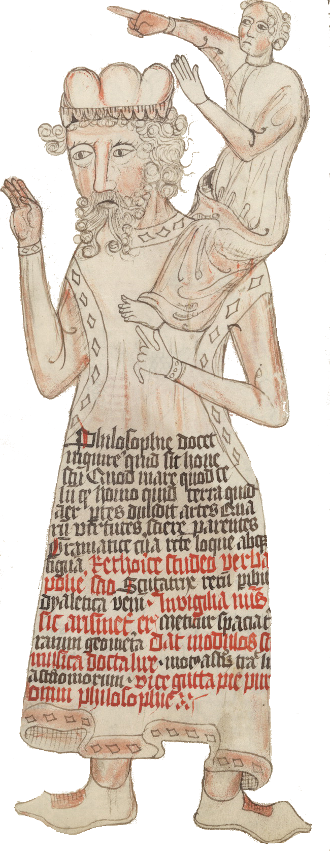
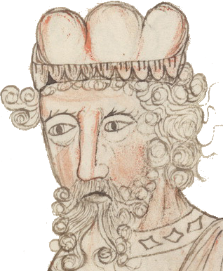
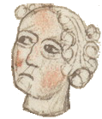
Key Idea: Shoulders of Giants
Dwarf: guides the Giants
Decomposes complex tasks into smaller tasks
Communicates the sub-tasks with the “language” of Giants.
Text Modular Networks:
Modules for different skills
Natural language for communication between modules
ModularQA: an implementation of this framework
The blind giant Orion carried Cedalion on his shoulders to act as the giant's eyes.
Notes:
A simple way to describe the idea here is: “standing on the shoulders of giants”.
The “giants” of our work are a bunch of models (or modules) for simple and rich-resource tasks; for example, a SQuAD solver or a symbolic solver like a calculator. These models are good at what they’re designed for, but they’re essentially blind at solving problems that are slightly more complex.
However, the “dwarf” of our problem is there to guide the “giants”. The dwarf breaks down a given complex question, decomposes it into sub-questions and communicates them to appropriate modules (“giants”).
A crucial issue here is that the communication between the “dwarf” and the “giants” is all done in natural language.
And in order for this language communication to be successful, “dwarf” needs to speak in a language that is understandable to “giants”. (this is very important. Let me repeat this).
We call this general family of architectures Text Modular Network, since they consist of “modules” for different skills, which uses natural language for the communication between its modules.
And I will present ModularQA as an implementation (instantiation) of Text Modular Networks.

Slide 73
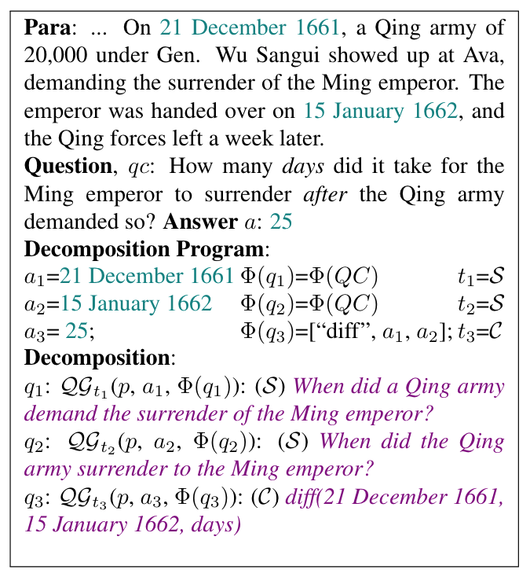
Generating Decompositions
Using cues from questions/passages, define the intermediate answers, vocabulary hints and potential sub-model
Doesn’t have to be perfect
Generate sub-questions that will lead to the intermediate answer
Use generators to produce questions in the “language” of QA sub-models
Ignore noisy decompositions
All answers not used
Too many question words not used
Too many new words introduced
Only step one needs to implement for a new complex task

Slide 74
ModularQA: Example
from HotPotQA
What was the nationality of the director of the "Little Big Girl" episode of "The Simpsons"?
Who directed the episode "Little Big Girl"?
Sub-Question Generator
Raymond S. Persi
SQuAD solver
What is Raymond S. Persi's nationality?
American
American
Notes:
Let’s see examples of how this would work.
…. ------ ### Training this model requires a next-question prediction dataset where each example is a step in the iterative progression of sub-question generation.

Slide 75
Language of Existing QA models
Paragraph: The first web browser was invented by Sir Tim Berners-Lee. Berners-Lee is the director of the World Wide Web Consortium (W3C), which oversees the Web’s continued development ...
SQuAD Q: What was Berners-Lee a director of?
What kind of questions can the QA model answer?
Can be automatically derived from the training data
Train a model to generate the question, given the context, answer and vocabulary hints
Can also be developed for a symbolic calculator
QGS(p, hints=[]): What is the W3C?
QGS(p, hints=[“Berners-Lee”, “director”]): What is Berners-Lee a director of?
The only step needed to implement for a new sub-model
Notes:
I am going to present the way we implemented our first version; I would note that now we have a more efficient implementation in the pipeline that is not published yet.
The first piece of the puzzle is to define the language of the communication.
Like I said before, our model should decompose questions in a language that is understandable to the individual modules.
How can this be done?
We build Question-Generation systems using the same data that was used for building QA modules. For example, if we’re going to use SQuAD solver as one of our modules, we build a QG system based on SQuAD data.
Essentially, the questions generated by this QG system are all understandable to the corresponding QA system.
That is the key intuition we will use in order to build noisy supervision for our question-decomposition module.

Slide 76
Generating [Noisy] Training Data
Goal: break down complex questions into noisy sub-questions:
Input: complex question & it’s answer
Output: list of, sub-questions & answers
We will use this data to train our model.
Input:
What was the nationality of the director of the "Little Big Girl" episode of "The Simpsons"?
A: American
Output:
Q1: Who directed the episode "Little Big Girl"?
A1: Raymond S. Persi
Q2: What is Raymond S. Persi's nationality?
A2: American
Notes:
We want to create training data of the following format for our decomposition module:
Input: Complex question
Output: [ sub-questions ]
That are semi-automatically generated.
Let expand on that.

Slide 77


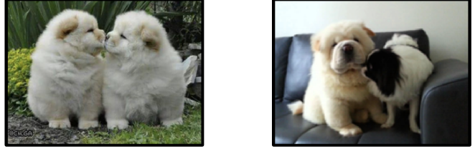

Characterizing models’ decision boundaries [Gardner et al. EMNLP-Findings’20]
Models of Language Problems
Measuring Our Progress
KMKKTCH. EMNLP-Findings’20
KCRUR. NAACL’18
PKR. NAACL’15
GKSKRB. TACL’21
ZKQR. EMNLP’19
KCRUR. NAACL’18
three
differently
Analyses
Two similarly-colored and similarly-posed chow dogs are face to face in one image.
cats
G et al. EMNLP-Findings’20 KKS. EMNLP’20
Notes:
Another chunk of my time is spent on analyzing models,
Whether they do what they’re supposed to do,
What are the unintended behaviors encoded in them
To highlight an example: In a recent work, we advocated for “contrast sets” as a practical way to measure models’ robustness to minor changes at the decision boundaries.

Slide 78
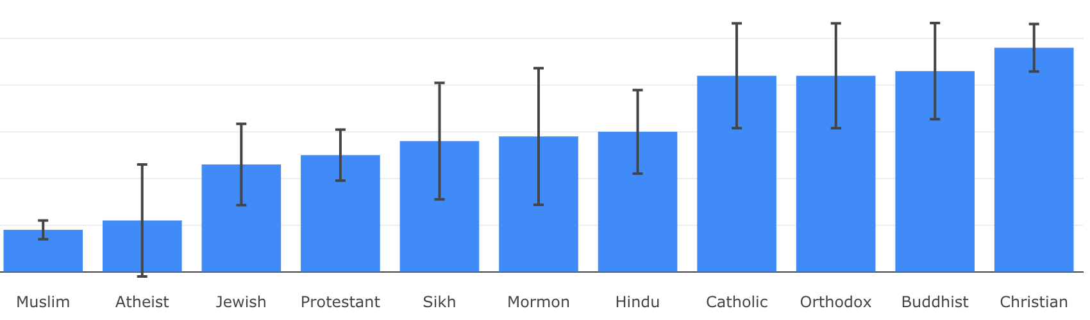

Social Biases in QA Models [Li et al. EMNLP-Findings’20]
Models of Language Problems
Measuring Our Progress
KMKKTCH. EMNLP-Findings’20
KCRUR. NAACL’18
PKR. NAACL’15
GKSKRB. TACL’21
ZKQR. EMNLP’19
KCRUR. NAACL’18
Analyses
NLP+Society
G et al. EMNLP-Findings’20 KKS. EMNLP’20
LKKSS. EMNLP-Findings’20 CKWCR. NAACL’19
Association of ethylic/religious groups with negative stereotypes
Notes:
Last but not least, we build models for problems that are more directly connected to societies.
Along this mindset, I have worked on problems related to social biases encoded in models

Slide 79
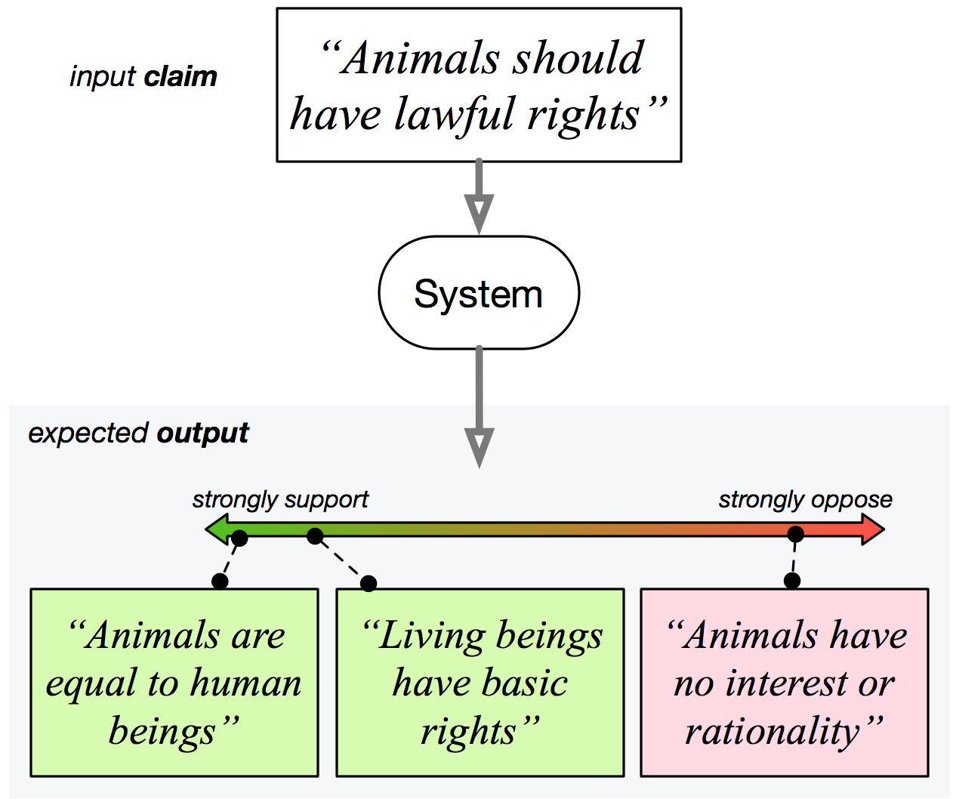
Diverse Perspective Discovery [Chen et al. NAACL’19]
Models of Language Problems
Measuring Our Progress
KMKKTCH. EMNLP-Findings’20
KCRUR. NAACL’18
PKR. NAACL’15
GKSKRB. TACL’21
ZKQR. EMNLP’19
KCRUR. NAACL’18
Analyses
NLP+Society
G et al. EMNLP-Findings’20 KKS. EMNLP’20
LKKSS. EMNLP-Findings’20 CKWCR. NAACL’19
Diverse perspectives to address the given claim.
Notes:
I have also dabbled in the problem domain of “information pollution”, where one needs to tackle issues on: discovery of perspectives, claim provenance, claim trustworthiness, etc. Very crucial problems for the age of “information abundance”.
# Another instance that I remain passionate about is the problem domain of “information pollution”, where one needs to tackle issues on: discovery of perspectives, claim provenance, claim trustworthiness, etc. Very crucial problems for the age of “information abundance”.

